Slide 1

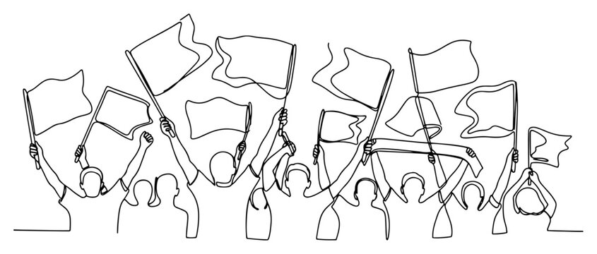
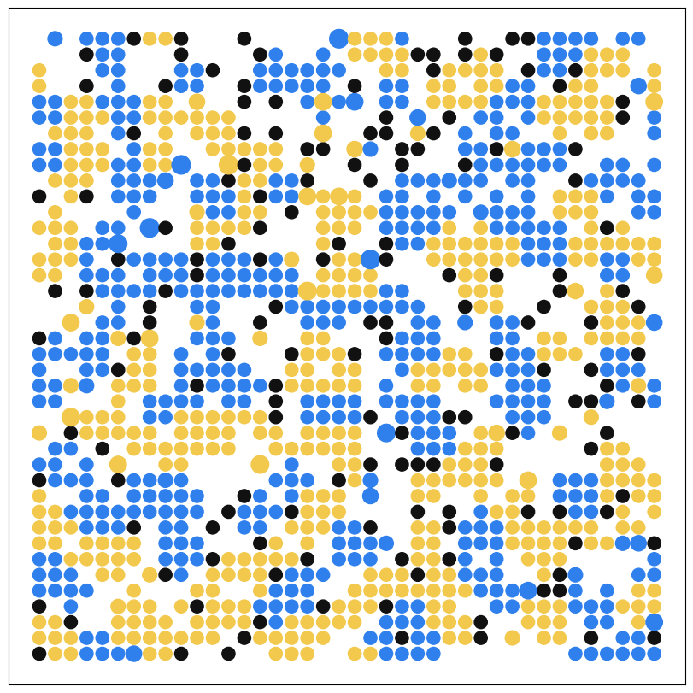
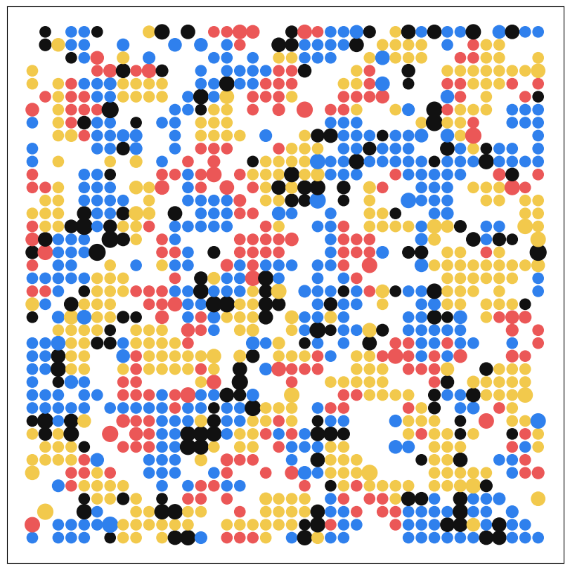
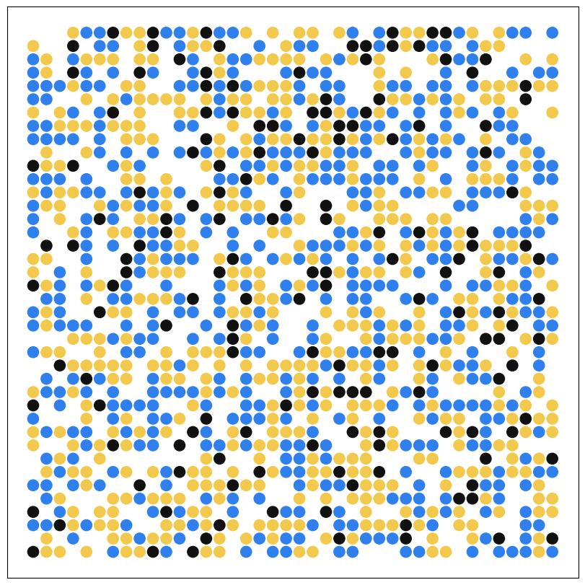
An agent-based comparison of strategies for mitigating football riots
Research Question: Does separation or normalization reduce football riot behaviour more effectively?
Fans have a chance to fight based on likelihood of arrest, likelihood of winning and a (logit) hawk dove game.
Police arrest fighting fans
Core Motivation
Riots are non-linear patterns emerging from local interactions between heterogeneous fans.
Home and away fans move if not enough same team in moore neighborhood
Random Initialization
Civil Violence Dynamics
Schelling Segregation
Unique Strengths
Emergent Patterns: Schelling segregation generates a natural segregation, affecting chance of interaction. Combined with inter- and intra- group dynamics to decide fighting.
Integrated Modeling: Combines Schelling clustering, civil violence, and police deterrence.
Key Use Case
Policy Testing:
Safely compare separation vs. normalization and police deployment strategies without real-world risks.

Slide 2
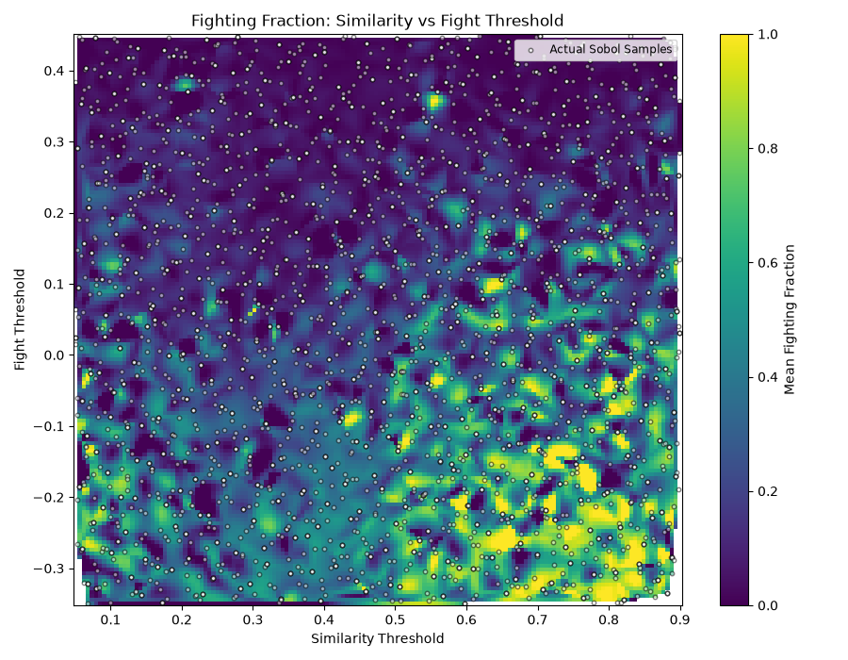
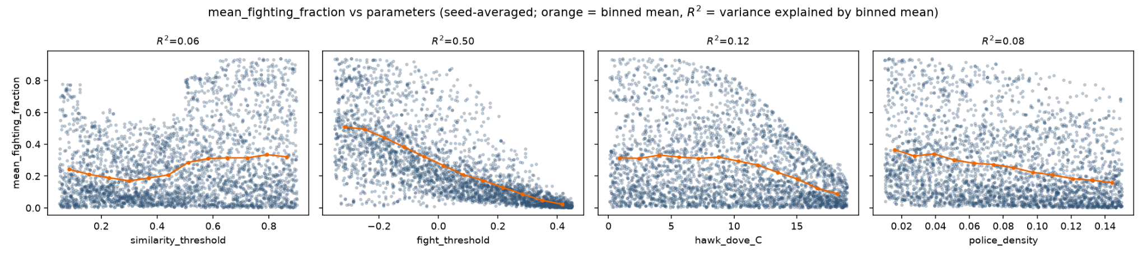
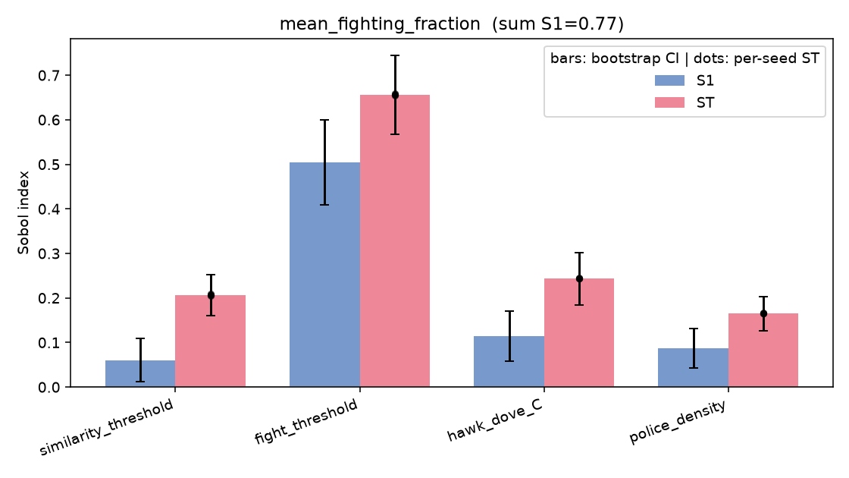
Sensitivity Analysis and Emergent Properties
Sensitivity Analysis
Fight threshold is the dominant driver; S1 and ST are highest in the Sobol bar chart.
There is clear interaction effects in all parameters tested.
Similarity threshold mostly yields interaction effects.
Emergent Properties
Simple rules yield self-organized riot patterns. Random separations (Sim Threshold of < 0.1 or > 0.5) combined with low fight threshold produces the most fighting.
Non-linear: Both the Similarity threshold and cost have non linear relations to the amount of fights happening.
Segregation collapses
Cost becomes important
Answer to Research Question
Interventions targeting individual aggression outperform spatial separation alone but spatial segregation has a significant interaction effect on the amount of aggression happening: in our model segregation helps in preventing fights.

Slide 3
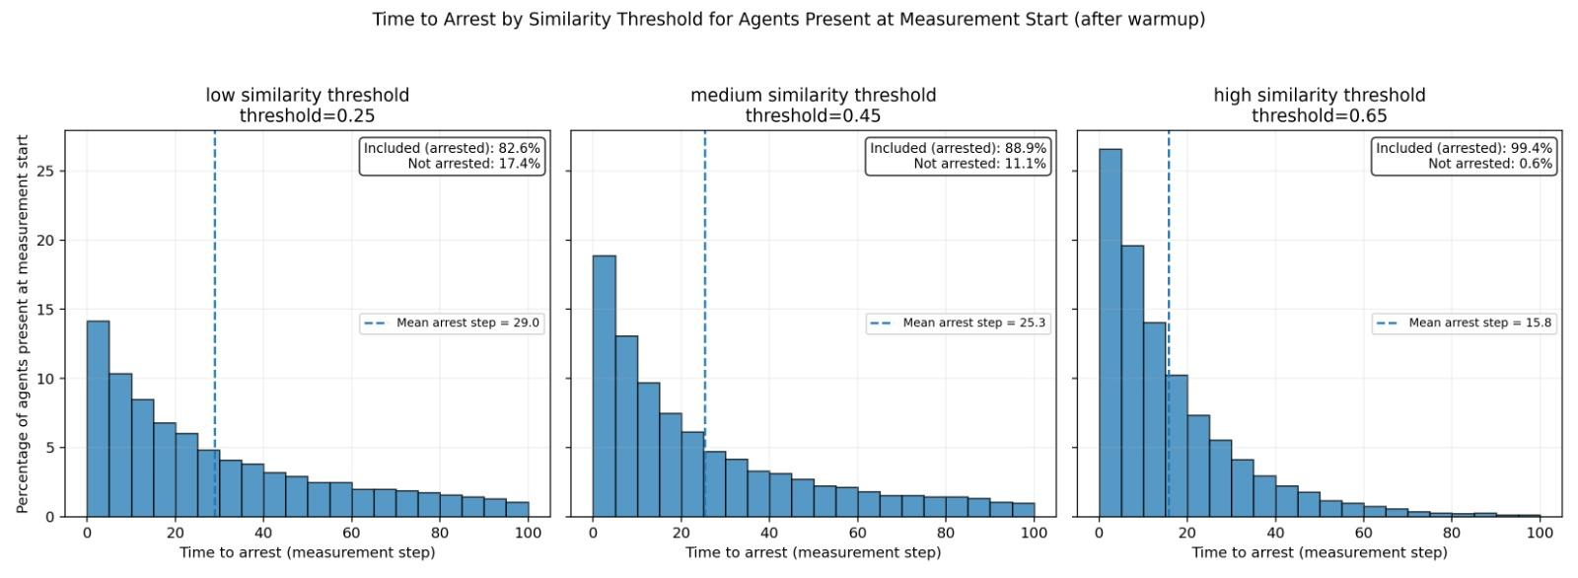
Appendix slide

